Slide 1
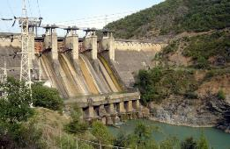
Technical Assistance on Preparation of River Basin Management Plans for Six Basins EuropeAid/140294/IH/SER/TR
Seppo Hellsten
Jarno Turunen
Hydromorphological assessment in WFD and HMWB in WFD implementation
26.5.2022
6RBMP Hydromorphological Meeting

Slide 2
Aim of the meeting
Discussion on criteria and scoring system for hydromorphological status assessment proposed by DGWM
Discussion on criteria for HMWBs assessment proposed from DGWM

Slide 3
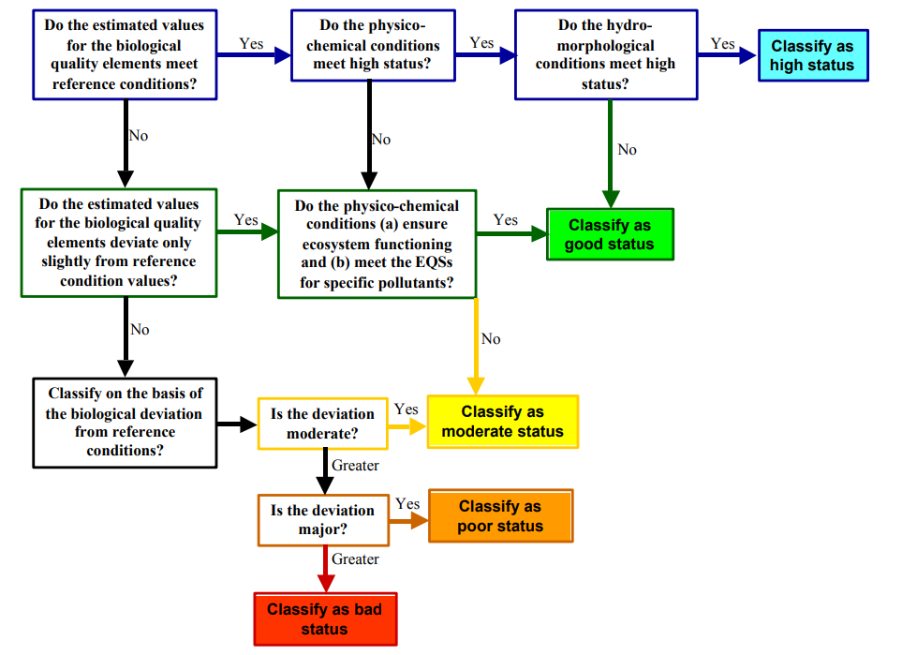
Role of hydromorhpology in WFD

Slide 4
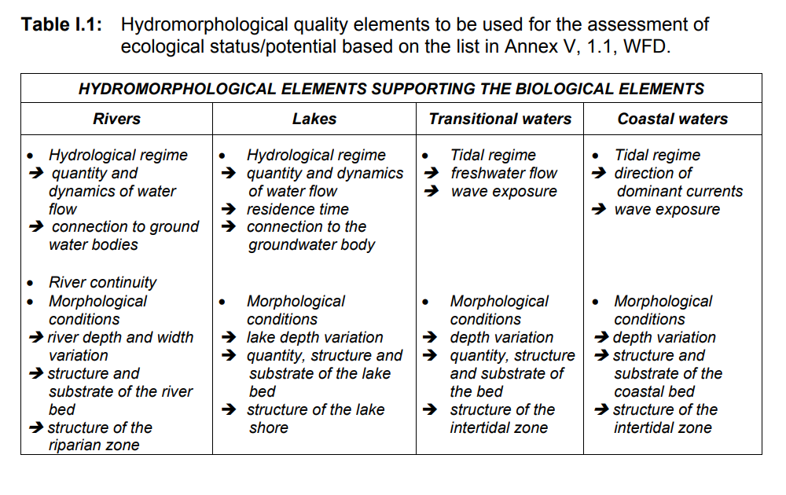
Hydromorphology in WFD

Slide 5
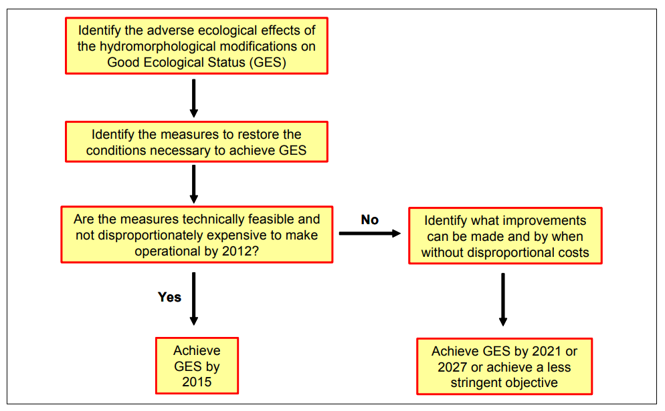
Natural waterbodies

Slide 6
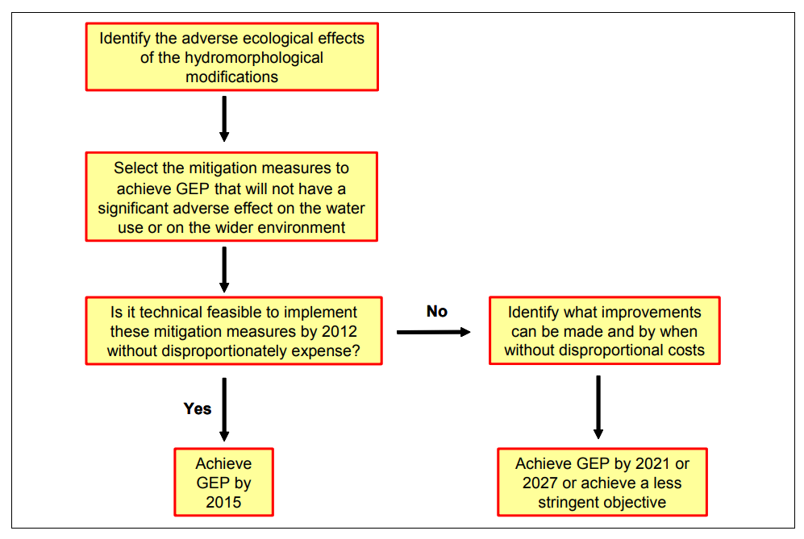
Heavily modified and artificial

Slide 7

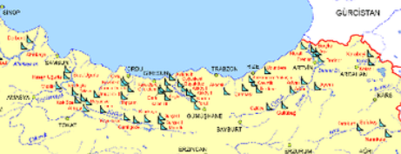
Technical Assistance on Preparation of River Basin Management Plans for Six Basins EuropeAid/140294/IH/SER/TR
Heavily modified and artificial waterbodies
Different environmental goals for physically modified waters
Process described in Heavily Modified Water Body (HMWB) & Artificial Water Body (AWB) guidance document (WFD CIS guidance document No. 4

Slide 8
1. Is water body artificial?
Yes
ARTIFICIAL
No
2. Is hydromorphological change significant?
Yes
No
3. Is ecological status good?
Yes
No
4. Is lowered status based on physical modifications of water bodies?
No
Yes
5. Is it possible to reach a good ecological status without any significant effects on use of water body (art. 4 (3))?
NATURAL
Yes
NO
6. Is it possible to reach benefits enabled by physical modifications by other means (art. 4 (3))?
Yes
No
HEAVILY MODIFIED

Slide 9
Next slides only optional…

Slide 10
1. Is water body artificial?
Yes
ARTIFICIAL
No
2. Is hydromorphological change significant?
Yes
No
3. Is ecological status good?
Yes
No
4. Is lowered status based on physical modifications of water bodies?
No
Yes
5. Is it possible to reach a good ecological status without any significant effects on use of water body (art. 4 (3))?
NATURAL
Yes
NO
6. Is it possible to reach benefits enabled by physical modifications by other means (art. 4 (3))?
Yes
No
HEAVILY MODIFIED

Slide 11
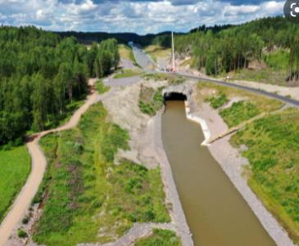
1. Is waterbody artificial?
Channel build on dry land
Reservoir/Lake which area is more than half on terrestrial land (area has doubled since damming)

Slide 12
1. Is water body artificial?
Yes
ARTIFICIAL
No
2. Is hydromorphological change significant?
Yes
No
3. Is ecological status good?
Yes
No
4. Is lowered status based on physical modifications of water bodies?
No
Yes
5. Is it possible to reach a good ecological status without any significant effects on use of water body (art. 4 (3))?
NATURAL
Yes
NO
6. Is it possible to reach benefits enabled by physical modifications by other means (art. 4 (3))?
Yes
No
HEAVILY MODIFIED

Slide 13
2. Is hydromorphological change significant?
Goal is to distinguish obvious cases
  need of direct hydromorphological criteria
Direct hydromorphological criteria should be waterproof
  change in ecological quality should be significant
  Example of river macroinvertebrates ecological status
Embankment%

Slide 14
1. Is water body artificial?
Yes
ARTIFICIAL
No
2. Is hydromorphological change significant?
Yes
No
3. Is ecological status good?
Yes
No
4. Is lowered status based on physical modifications of water bodies?
No
Yes
5. Is it possible to reach a good ecological status without any significant effects on use of water body (art. 4 (3))?
NATURAL
Yes
NO
6. Is it possible to reach benefits enabled by physical modifications by other means (art. 4 (3))?
Yes
No
HEAVILY MODIFIED

Slide 15
3. Is ecological status good?
When ecological status is good, water body cannot be designated as heavily modified, although hydro-morphological change is significant
Difficult task for defining ecological status
  Temporary/seasonal waters
  Ecological indicators are sensitive for eutrophication, not hydromorphological change
  Ecological data is missing

Slide 16
1. Is water body artificial?
Yes
ARTIFICIAL
No
2. Is hydromorphological change significant?
Yes
No
3. Is ecological status good?
Yes
No
4. Is lowered status based on physical modifications of water bodies?
No
Yes
5. Is it possible to reach a good ecological status without any significant effects on use of water body (art. 4 (3))?
NATURAL
Yes
NO
6. Is it possible to reach benefits enabled by physical modifications by other means (art. 4 (3))?
Yes
No
HEAVILY MODIFIED

Slide 17
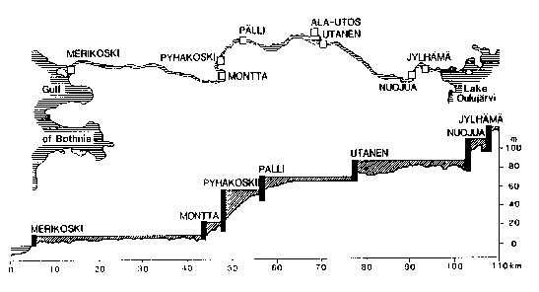
4. Is lowered status based on physical modifications of water bodies?
Easy
  large lakes, dammed rivers
Difficult
  eutrophicated small rivers
  shallow regulated lakes
  lakes with lowered water level

Slide 18
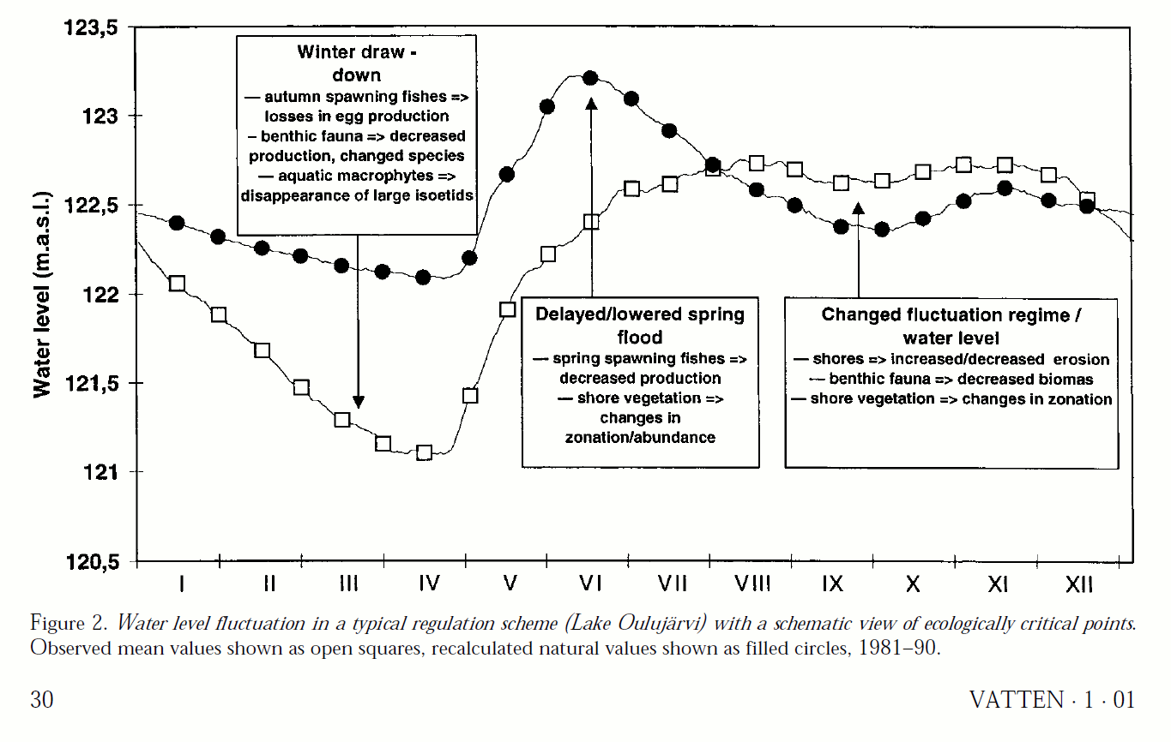
Impacts of lake water level regulation Lake Oulujärvi
Natural
Regulated
M.Marttunen, S.Hellsten and A.Keto 2001:
Sustainable development of Lake regulation in Finnish lakes.
Vatten 57:29-37. Lund 2001

Slide 19
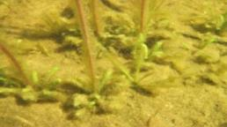
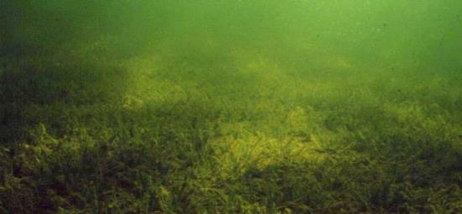
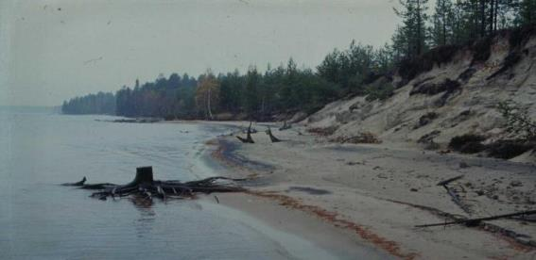
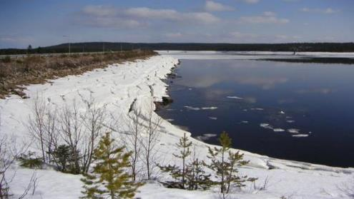
Winter draw-down summarises the environmental effects of water level regulation!

Slide 20
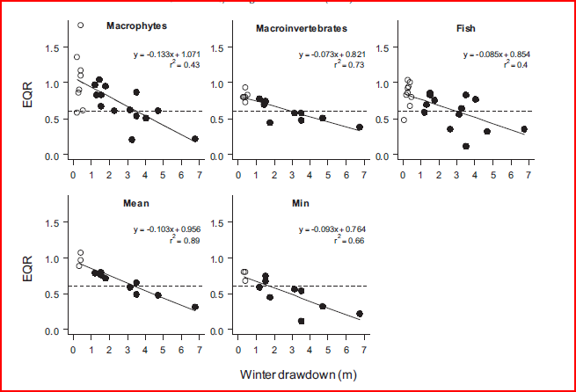


Slide 21
1. Is water body artificial?
Yes
ARTIFICIAL
No
2. Is hydromorphological change significant?
Yes
No
3. Is ecological status good?
Yes
No
4. Is lowered status based on physical modifications of water bodies?
No
Yes
5. Is it possible to reach a good ecological status without any significant effects on use of water body (art. 4 (3))?
NATURAL
Yes
NO
6. Is it possible to reach benefits enabled by physical modifications by other means (art. 4 (3))?
Yes
No
HEAVILY MODIFIED

Slide 22
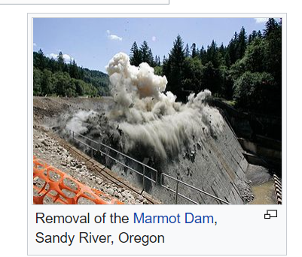
5. Is it possible to reach a good ecological status without any significant effects on use of water body (art. 4 (3))?
Physical modifications are due to flood protection, hydropower production, irrigation, drinking water need and recreational use.
Problematic term ”significant effect on use”
  local, regional or national significance?
Value of water should be evaluated
Wikipedia

Slide 23
1. Is water body artificial?
Yes
ARTIFICIAL
No
2. Is hydromorphological change significant?
Yes
No
3. Is ecological status good?
Yes
No
4. Is lowered status based on physical modifications of water bodies?
No
Yes
5. Is it possible to reach a good ecological status without any significant effects on use of water body (art. 4 (3))?
NATURAL
Yes
NO
6. Is it possible to reach benefits enabled by physical modifications by other means (art. 4 (3))?
Yes
No
HEAVILY MODIFIED

Slide 24
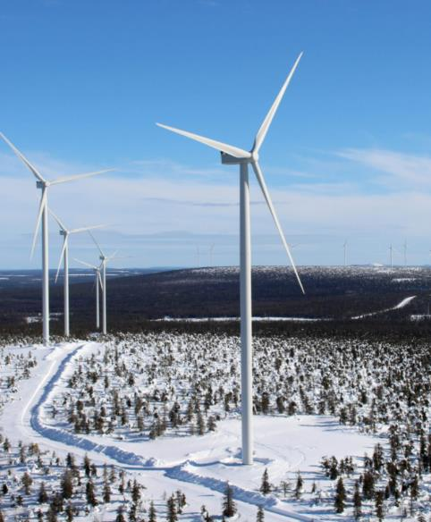
6. Is it possible to reach benefits enabled by physical modifications by other means (art. 4 (3))?
Usually easy to analyse
  Hydropower lakes alternative means for hydropower production are more harmful for environment – wind or solar power?
  Other options for flood protection and irrigation are difficult
There might be some obsolate dams is small rivers
  Dam removal processes taking place all over Europe
Tuulivoimayhdistys

Slide 25
1. Is water body artificial?
Yes
ARTIFICIAL
No
2. Is hydromorphological change significant?
Yes
No
3. Is ecological status good?
Yes
No
4. Is lowered status based on physical modifications of water bodies?
No
Yes
5. Is it possible to reach a good ecological status without any significant effects on use of water body (art. 4 (3))?
NATURAL
Yes
NO
6. Is it possible to reach benefits enabled by physical modifications by other means (art. 4 (3))?
Yes
No
HEAVILY MODIFIED

Slide 26
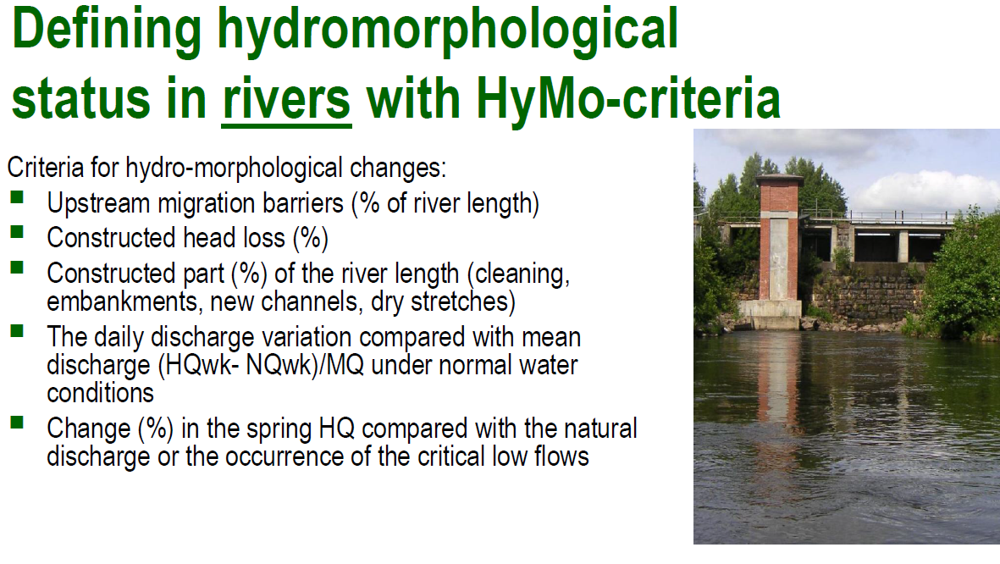

Slide 27
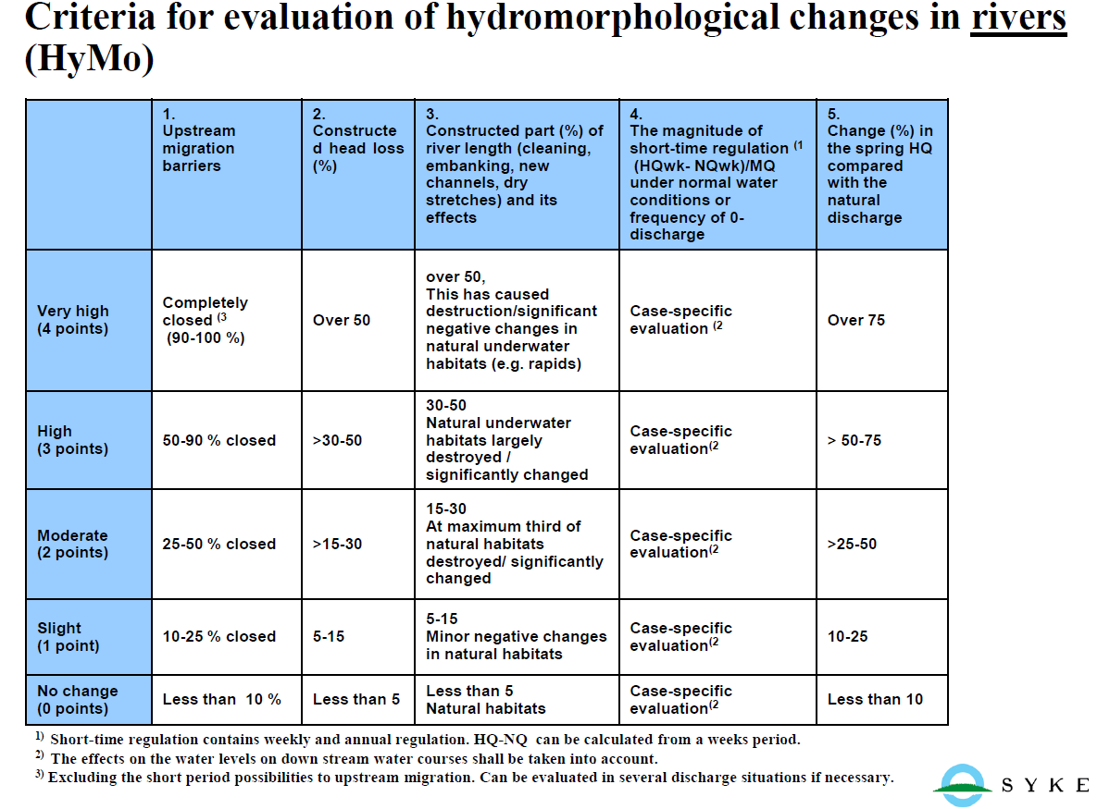

Slide 28
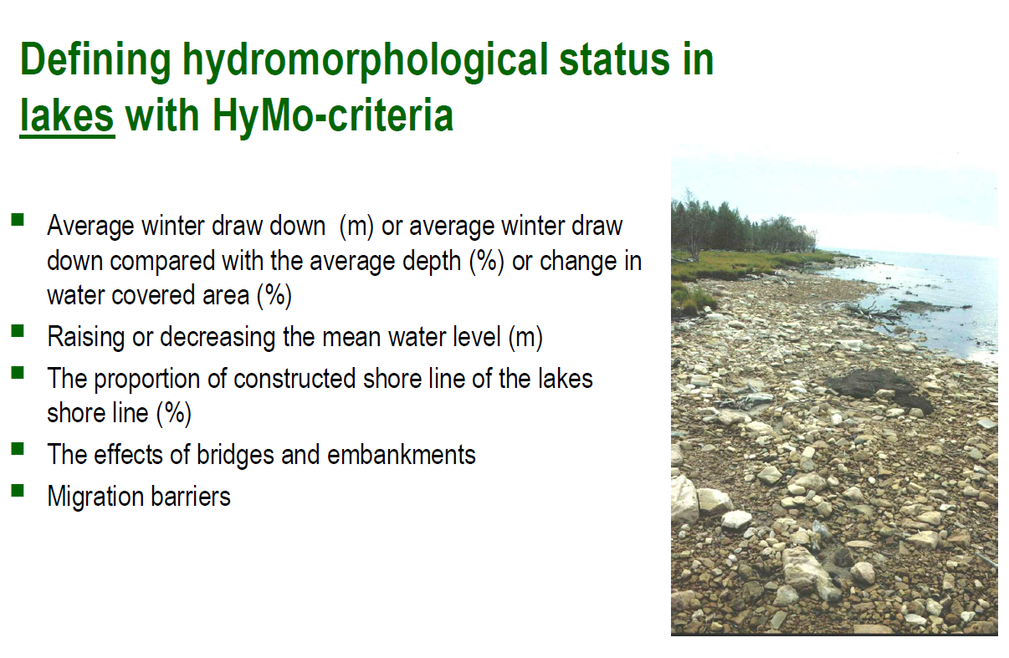

Slide 29
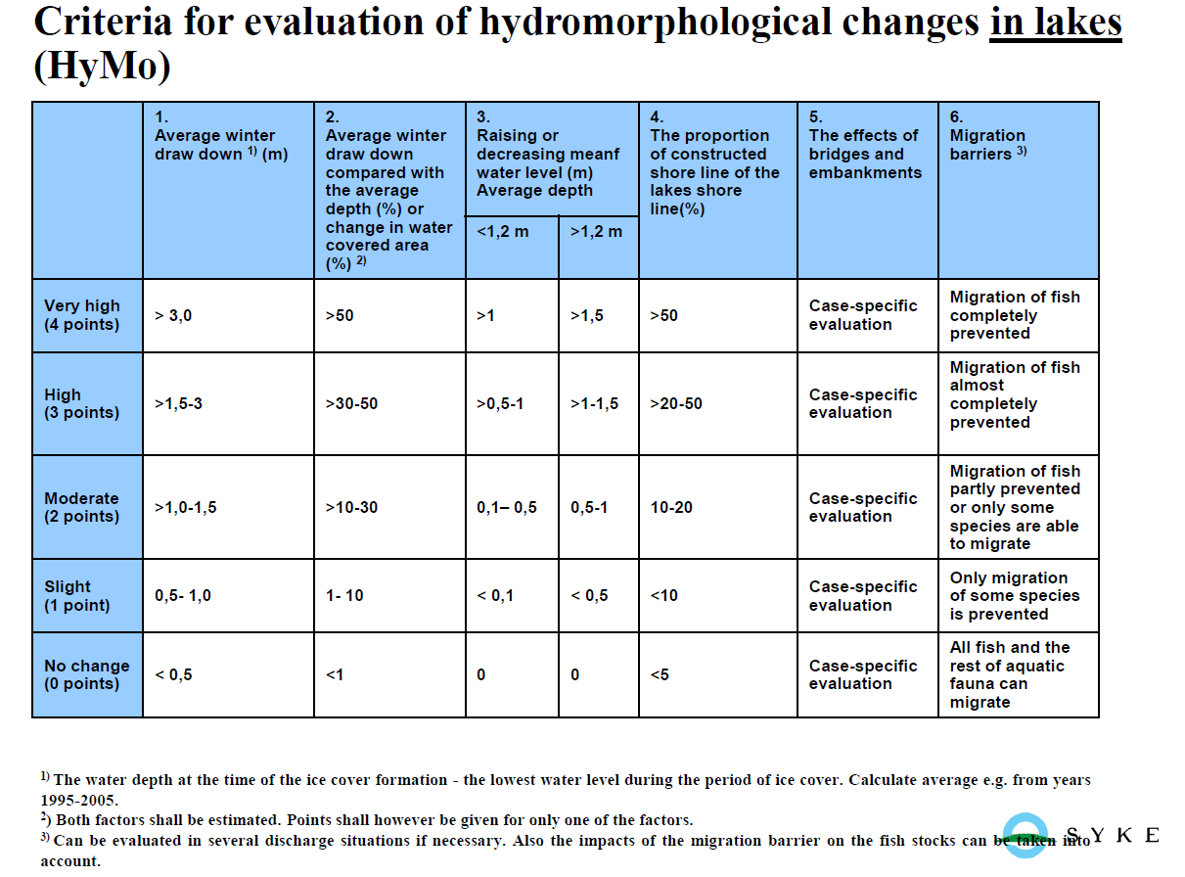

Slide 30
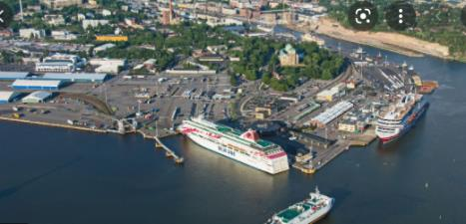
Defing hydromorphological status in coastal waters
 | Share of constructed shoreline of total shoreline (%) | Share of modified/dredged bottom (%) | Effect of bridges and embankments (%) | Natural connection to open sea
Very high (4 points) | > 50 | >5 | Case specific evaluation | Completely closed
High (3 points) | 20-50 | >2-5 | Case specific evaluation | Mostly closed
Moderate (2 points) | 10-20 | 1-2 | Case specific evaluation | Partly closed
Slight (1 points) | <10 | <1 | Case specific evaluation | Partly affected
No change (O points) | <5 | 0 | Case specific evaluation | Open
Share of constructed shoreline of total shoreline (%)
Share of modified/dredged bottom (%)
Effect of bridges and embankments (%)
Natural connection to open sea

Slide 31
Evaluation of hydromorphological change by Hymo-criteria – total scoring
Level of hydro-morphological change | Changes in the hydro-morphological status | HyMo-points
0 | No change | 0 – 1
1 | Slight change | 2 – 3
2 | Quite significant change | 4 – 5
3 | Significant change | 6 – 9
4 | Very significant change | 10 ->
0-1 p.
Excellent status
2-3 p.
HyMo-points
4-5 p.
6-9 p.
Moderate status or
worse
10- p.
Heavily modified

Slide 32
Discussion on criteria and scoring system for hydromorphological status assessment proposed by DGWM

Slide 33
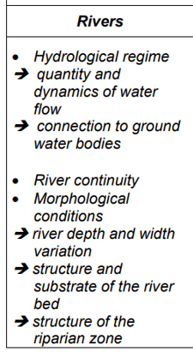
River HyMo-status assessment parameters
Alltogether 12 parameters
All are very suitable to WFD requirements
However, less detail could be enough for the
requirements of WFD?
Intercorrelation between the parameters? No
loss of key HyMo-information with less variables?
Possible to do lighter hymo assessment for the
present project needs?
Hydromorphological Monitoring and Assessment Parameters​
1. Longitudinal Flood Structures​
2. Transitional Structures​
3. Regulators​
4. The Effects of Dams and Ponds in the Drainage Area​
5. The Effect of Flow Variation Caused by Hydroelectric Power Plants​
6. Structures That Do Not Allow Sediment Transition​
7. Structures That Do Not Allow Fish Passage​
8. Unnatural Land Use (30m)​
9. Unnatural Land Use (100m)​
10. Natural Vegetation (30m)​
11. Natural Vegetation (100m)​
12. Water Abstraction​
WFD

Slide 34
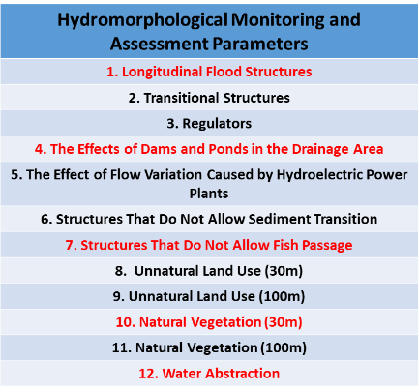
River HyMo-parameter suggestions to WFD assessment in 6Basins
1. Longitudinal flood structures
  Excellent parameter to describe connecitivity to
  floodplains and channelization
4. The Effects of Dams and Ponds in the Drainage Area
  Excellent parameter to describe ecological connectivity
7. Structures That Do Not Allow Fish Passage​
  Excellent parameter to describe ecological connectivity
  Might also capture changes in sediment transition
10. Natural Vegetation (30m)​
  Riparian land use important variable in WFD hymo-asses
  sment
  One land use parameter should be enough, 30 m scale is
  probably more ecologically influential than 100 m scale
12. Water Abstraction​
  Important parameter to quantify deviations from natural flow regime

Slide 35
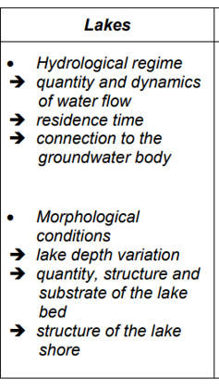
Lakes HyMo-status assessment parameters
Alltogether 11 parameters
All are very suitable to WFD requirements
However, less detail could be enough for the
requirements of WFD?
Intercorrelation between the parameters? No
loss of key HyMo-information with less variables?
Possible to do lighter hymo assessment for the
present project needs?
Hydromorphological Monitoring and Assessment Parameters​
1. Lake Surface Area Change​
2. The Effect of Dams and Ponds of which Reservoir is Located in the Drainage Area on the Hydrological Regime of the Lake​
3. Regulator​
4. Transitional Structures​
5. Longitudinal Flood Structures;​
6. Lake Coast Embankment and Modification Status on the Coast​
7. Unnatural Land Use (30m)​
8. Unnatural Land Use (100m)​
9. Natural Vegetation (30m)​
10. Natural Vegetation (100m)​
11. Water Abstraction​
WFD

Slide 36
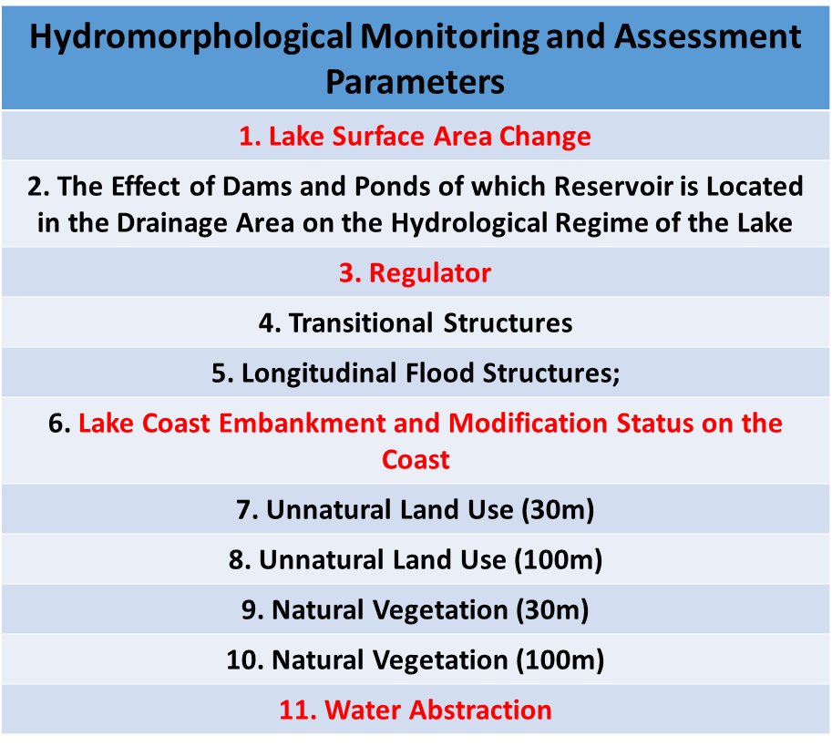
Lake HyMo-parameter suggestions to WFD assessment in 6basins
1. Lake Surface Area Change
  Excellent parameter to quantify morphological changes
3. Regulator
  Important to quantify water flow regulators that influence lake inflow
6. ​Lake Coast Embankment and Modification Status on the Coast​
  Excellent parameter to assess lake shore naturalness
11. Water abstraction
  Important variable to quantify water level fluctuation
Riparian land use has less importance in lakes compared to streams

Slide 37
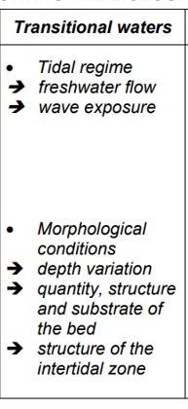
Transitional river HyMo-status assessment parameters
Alltogether 13 parameters
All are very suitable to WFD requirements
However, less detail could be enough for the
requirements of WFD?
Intercorrelation between the parameters? No
loss of key HyMo-information with less variables?
Possible to do lighter hymo assessment for the
present project needs?
Hydromorphological Monitoring and Assessment Parameters​
1. Longitudinal Flood Structures​
2. Transitional Structures​
3. Regulators​
4. The Effects of Dams and Ponds in the Drainage Area​
5. The Effect of Flow Variation Caused by Hydroelectric Power Plants​
6. Structures That Do Not Allow Sediment Transition​
7. Structures That Do Not Allow Fish Passage​
8. Unnatural Land Use (30m)​
9. Unnatural Land Use (100m)​
10. Natural Vegetation (30m)​
11. Natural Vegetation (100m)​
12. Water Abstraction​
13. Structures That Affect the Wave Flow​
WFD

Slide 38
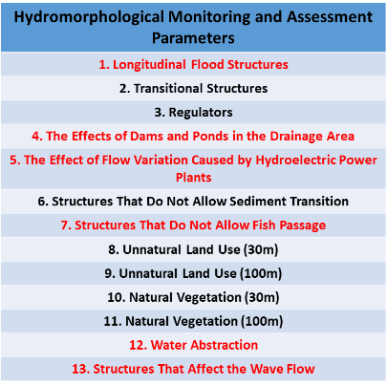
Transitional river HyMo-parameter suggestions to WFD assessment in 6basins
1. Longitudinal flood structures
  Excellent parameter to describe connecitivity to
  floodplains and channelization
4. The Effects of Dams and Ponds in the Drainage Area
  Excellent parameter to describe ecological connectivity to upstream
  form the transitional area
5. The Effect of Flow Variation Caused by Hydroelectric Power Plants​
  Flow variation due to hydropower production can have a large effect
  on the salinity of the transitional zone
7. Structures That Do Not Allow Fish Passage
  Excellent parameter to describe ecological connectivity
  Might also capture changes in sediment transition
12. Water Abstraction​
  Important parameter to quantify deviations from natural flow regime→
  influences the salinity gradient
13. Structures That Affect the Wave Flow​
  Good parameter to describe changes in wave and tidal influence

Slide 39
Transitional lakes HyMo-status assessment parameters
Alltogether 12 parameters
All are very suitable to WFD requirements
However, less detail could be enough for the
requirements of WFD?
Intercorrelation between the parameters? No
loss of key HyMo-information with less variables?
Possible to do lighter hymo assessment for the
present project needs?
Hydromorphological Monitoring and Assessment Parameters​
1. Lake Surface Area Change​
2. The Effect of Dams and Ponds of which Reservoir is Located in the Drainage Area of the Lake on the Hydrological Regime of the Lake​
3. Regulator​
4. Transitional Structures​
5. Longitudinal Flood Structures;​
6. Lake Coast Embankment and Modification Status on the Coast​
7. Unnatural Land Use (30m)​
8. Unnatural Land Use (100m)​
9. Natural Vegetation (30m)​
10. Natural Vegetation (100m)​
11. Water Abstraction​
12. Structures That Affect the Wave Flow​
WFD

Slide 40
Transitional lake HyMo-parameter suggestions to WFD assessment in 6basins
Hydromorphological Monitoring and Assessment Parameters​
1. Lake Surface Area Change​
2. The Effect of Dams and Ponds of which Reservoir is Located in the Drainage Area of the Lake on the Hydrological Regime of the Lake​
3. Regulator​
4. Transitional Structures​
5. Longitudinal Flood Structures;​
6. Lake Coast Embankment and Modification Status on the Coast​
7. Unnatural Land Use (30m)​
8. Unnatural Land Use (100m)​
9. Natural Vegetation (30m)​
10. Natural Vegetation (100m)​
11. Water Abstraction​
12. Structures That Affect the Wave Flow​
1- Lake Surface area reflects change in volume.
2. The Effect of Dams and Ponds of which Reservoir is Located in the Drainage Area of the Lake on the Hydrological Regime of the Lake​
  Good parameter to quantify changes in freshwater inflow to transitional lake lagoon
11. Water abstraction
  Good parameter to quantify water withdrawal affecting flow regime to transitional lake lagoon
12. Structures that affect wave flow
  Good parameter to quantify changes in wave exposure and tidal influence

Slide 41
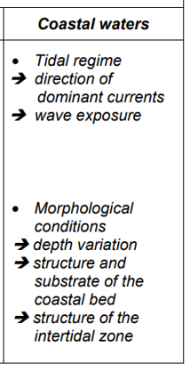
Coastal HyMo-status assessment parameters and WFD suggestions
Alltogether 4 parameters
2 parameters could be enough for WFD requirements
1. Coastal Length with Anthropogenic Structures.​
  Good parameter to quantify coastal infrastructure
  and modifications.
4. Structures that affect the wave regime
  Good parameter to quantify changes in wave exposure
Hydromorphological Monitoring and Assessment Parameters​
1. Coastal Length with Anthropogenic Structures.​
2. Land Use in the Area Near the Coast​
3. The Effect of Large Barriers in the Drainage Area on the Flow Regime​
4. Structures that Affect the Wave Regime​
WFD

Slide 42
Discussion on criteria for HMWBs assessment proposed from DGWM

Slide 43
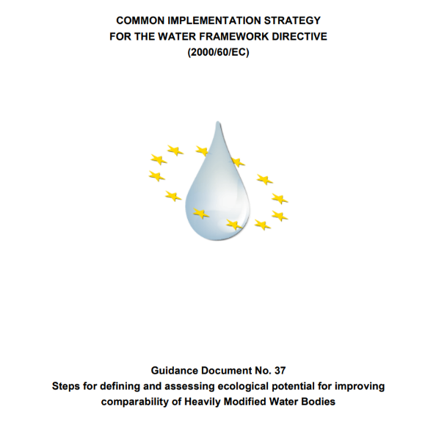
Defining Environmental objectives

Slide 44
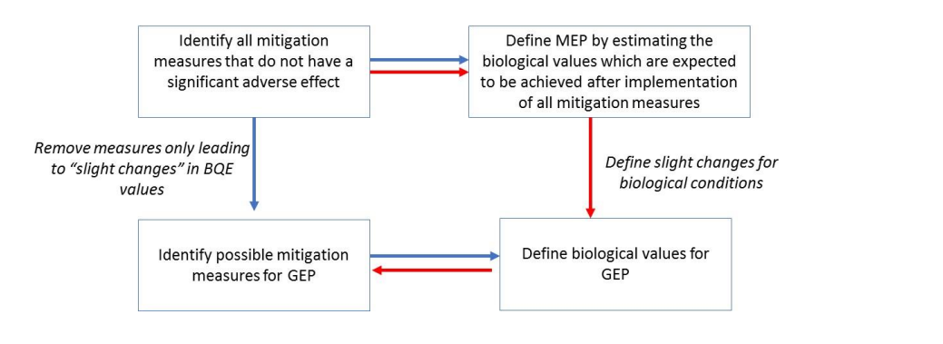

Slide 45
Setting environmental objectives!

Slide 46
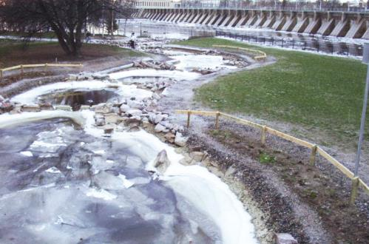
Examples of restoration measures in rivers
Reduction of water level fluctuation
Enhancing river continuity by fish ways and bypass channels
Restoration of main channel and shores
Restoration of bypass channels
Restoration of tributaries
Removal of old protecting structures and modification of littoral areas

Slide 47
THE MOST DIFFICULT ISSUES
How much we can harm use of water body to reach GOOD ecological potential!
  Estimations between 0,5 – 3 % of hydropower price etc.
There is no sense to build fishway, if there are no spawning grounds available
  How much stocking is allowed
Restoration costs are part of programme of measures
  Skip them in designation and ecological status assessment

Slide 48
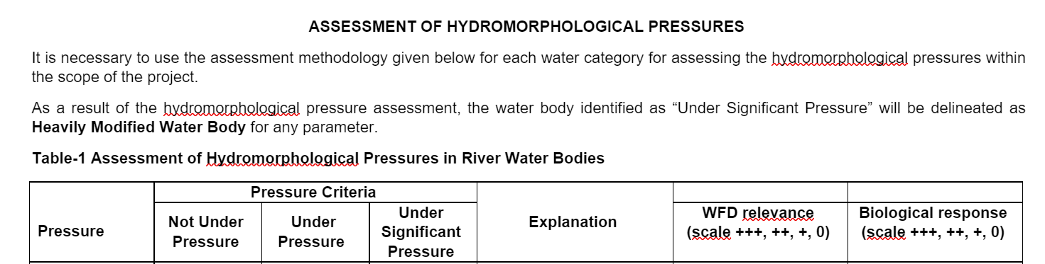
Proposal of AWB/HMWB designation

Slide 49
Rivers – HMWB/AWB designation suggestions in 6basins
Dams and Ponds > 50%
Water Abstraction or Water Transfer > 50%
Irrigation and HEPP Regulators > 2 per km
Coastal Reinforcement or Coastal Flood Structures > 60%

Slide 50
Lakes – HMWB/AWB designation suggestions in 6basins
The Amount of Change in the Lake Surface Area > 40%
Coastal Reinforcement or Coastal Flood Structures > 60%

Slide 51
Transitional rivers – HMWB/AWB designation suggestions in 6basins
Dams and Ponds
  (Dam Inlet Flow - Dam Outlet Flow) / Dam Inlet Flow ratio >30%
Coastal Reinforcement or Coastal Flood Structures >50%

Slide 52
Transitional lakes – HMWB/AWB designation suggestions in 6basins
The Amount of Change in the Lake Surface Area > 40%
Structures which affect on wave and tidal flow?

Slide 53
Coastal waters – HMWB/AWB designation suggestions in 6basins
Anthropogenic Structures in the Coastal Water Body > 40%

Slide 54
Thank you for your attention!
Seppo.Hellsten@syke.fi
Jarno.Turunen@syke.fi

