Slide 1
Technical Assistance on Preparation of River Basin Management Plans for Six Basins EuropeAid/140294/IH/SER/TR
Establishing reference conditions for biological quality elements
May 26, 2022, Ankara
Jukka Aroviita, SYKE

Slide 2
General on establishing reference conditions
WFD: Reference conditions and ecological class boundaries must be established for all surface water body types and all relevant quality elements
The establishment of reference conditions and the establishment of ecological quality class boundaries are closely interconnected
EU CIS WFD Guidance Document N° 10 - Rivers and Lakes - Typology, Reference Conditions and Classification Systems

Slide 3
Reference condition are crucial for the outcome of classification and RBMPs
The approaches for establishment of reference conditions and ecological quality class boundaries involve several technical considerations
The considerations are crucial for the judgement of the risk that individual water bodies will fail to reach the overall objective good water status
EU CIS WFD Guidance Document N° 10 - Rivers and Lakes - Typology, Reference Conditions and Classification Systems

Slide 4
Need for infrastructure
Paramount to successful work is infrastructure consisting of:
  Expertise
  Available data and databases
  Assessment methods
  Models and other tools
  Organizational structure
EU CIS WFD Guidance Document N° 10 - Rivers and Lakes - Typology, Reference Conditions and Classification Systems

Slide 5
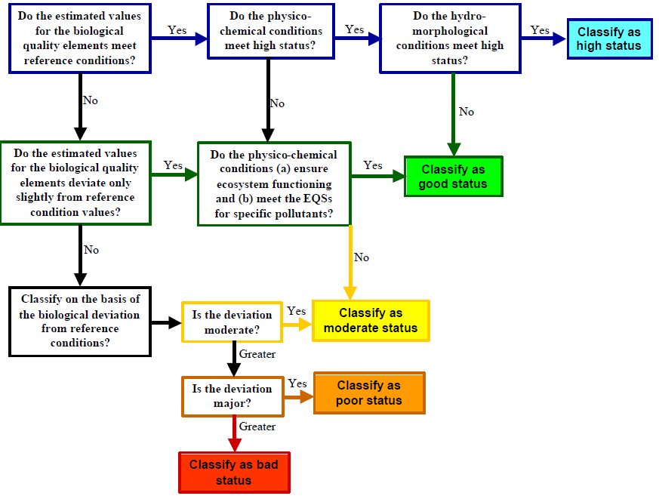
REF COND!
The WFD assessment is based on measured deviation from the reference conditions
REF COND!
REF COND!
WFD Guidance Document No 10 Rivers and Lakes – Typology, Reference Conditions and Classification

Slide 6
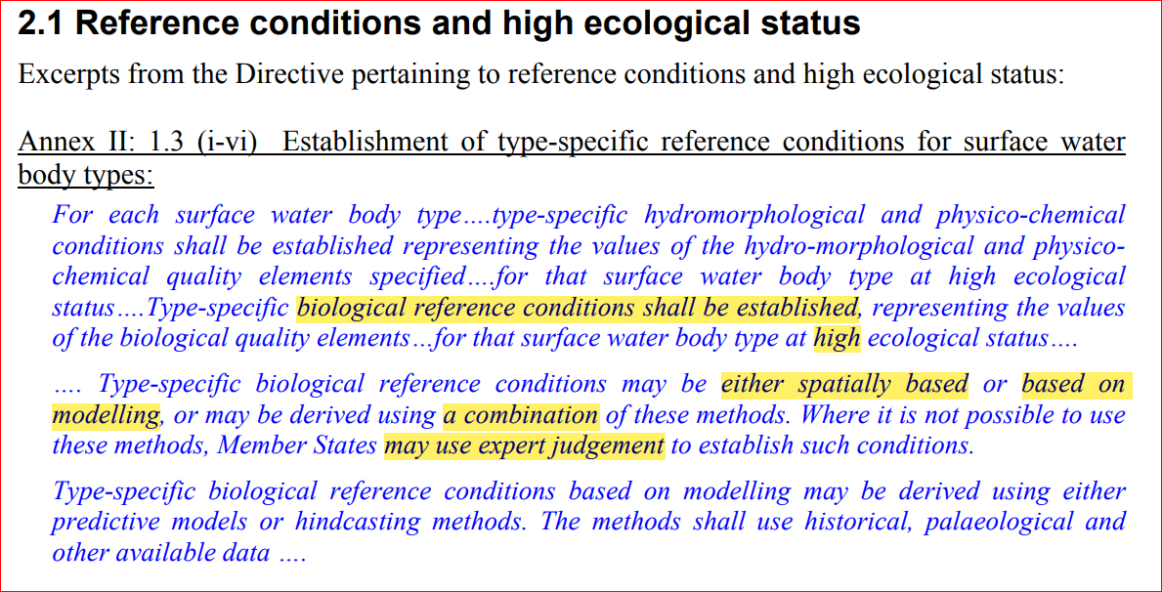
How should reference condition be technically established?
Spatially based
(with typology)
Modelling
Combination
Expert judgement
EU CIS WFD Guidance Document N° 10 - Rivers and Lakes - Typology, Reference Conditions and Classification Systems

Slide 7
The important considerations for well-performing classification systems
The most important thing is to have sufficiently small reference site variation in biological indices/metrics within the types
Why?: To be able to establish class boundaries and to be able to detect degradation of biological quality
Key considerations:
  What is the amount of natural variation within a type?
  What is the relationships of biological index/metric values to the measured pressures/stressors?
  <- These information are needed to know whether a method is good or not

Slide 8
The importance of reference variation on classification system and assessment:
WFD Goals:
Not acceptable
=> Restore/manage
Acceptable
=> Protect
WFD Classes:
Bad
Poor
Mod.
Good
High
Variation among reference sites
0
1
Ecological quality (EQR of an index)

Slide 9
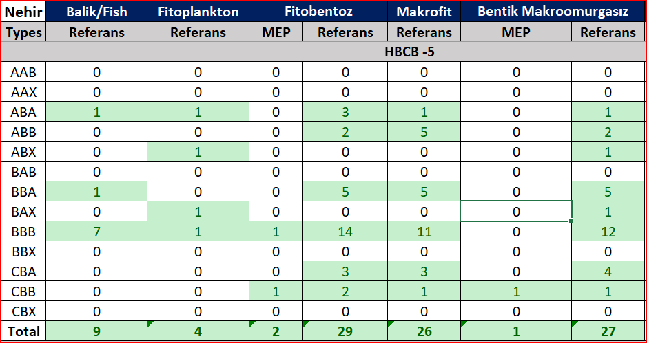
The number of Reference Project reference sites in the 6 Basins
In most cases <5 sites per type per HBCB.
=> Clear need to use data from other basins and modelling to increase confidence and to fill in the types with no reference sites.
Evolution of all companents Ref stations_6RB_newtypes_table.xlsx

Slide 10

What data are in minimum needed to establish type-specific reference conditions for 6RBMP?
Reference data (= Reference Project data)
  Stations and water bodies from all Turkey basins
  Types according to digitalization typology
  All BQE raw index/metric values for stations
  Raw values of typology descriptors (altitude, slope, etc) for stations and/or water bodies
  Any other available information (coordinates, river size) about natural characteristics of the stations and/or water bodies

Slide 11
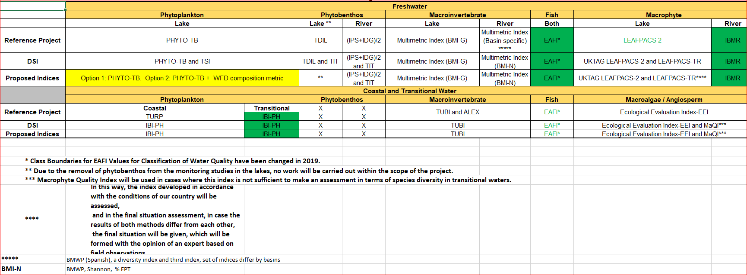
BQE indices and metrics in Reference Project and in 6RBMP
=> Most indices/metrics are the same, few new ones or changed, some differ to small extent
All index values are required to establish the reference conditions

Slide 12
Step-by-step approach for establishing reference conditions and class boundaries for BQEs
Establish database (water bodies, monitoring sites, BQE indices)
Identify reference sites
Reference sites available
Use types or establish and use modeling
Estimate confidence of RC, establish class boundaries
Establish type-speciflc RC for relevant BQEs
Differentiate water body types
Use other types or establish and use models + expert judgement
Reference sites not available
Revise
Low confidence
RC = Reference Conditions
BQE = Biological Quality Element

Slide 13
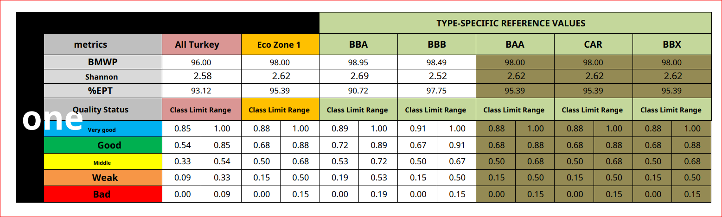
Current situation of RC between BQEs
Situation differs among BQEs:
Same criteria for all water bodies (no-types)
Type-specific criteria
  old types
  new types
Site-specific models
River benthic invertebrates, Eco Zone 1:
Nehir Bentik Makroomurgasız İndeks.tr.en.pdf
Need to evaluate the confidence and usability given the new types
Which can be used and which need to be (re)-established

Slide 14
Suggestions of next steps in 6RBMP
Guidance and examples
  Examples using Reference Project data, for all BQEs
  How to evaluate reference variation, how to estimate confidence and establish H/G class boundaries
  Spatial approach and modelling examples
Establishment the new type-specific reference values and class boundaries
Calculation of indices, EQRs and BQE classification

Slide 15
Final remark: important to reach wide acceptance
The technical considerations of reference conditions -approaches might not be transparent to the public, water users and stakeholders
But, given the importance of the considerations: for the judgement of the risk of individual water bodies failing to reach the overall objective good water status:
  => It is important to involve the public, water users and stakeholders to reach acceptance for the quality class boundaries (also in line with Article 14 in the Directive to involve all interested parties)
EU CIS WFD Guidance Document N° 10 - Rivers and Lakes - Typology, Reference Conditions and Classification Systems

Slide 16
Thank you for your attention!

Slide 17
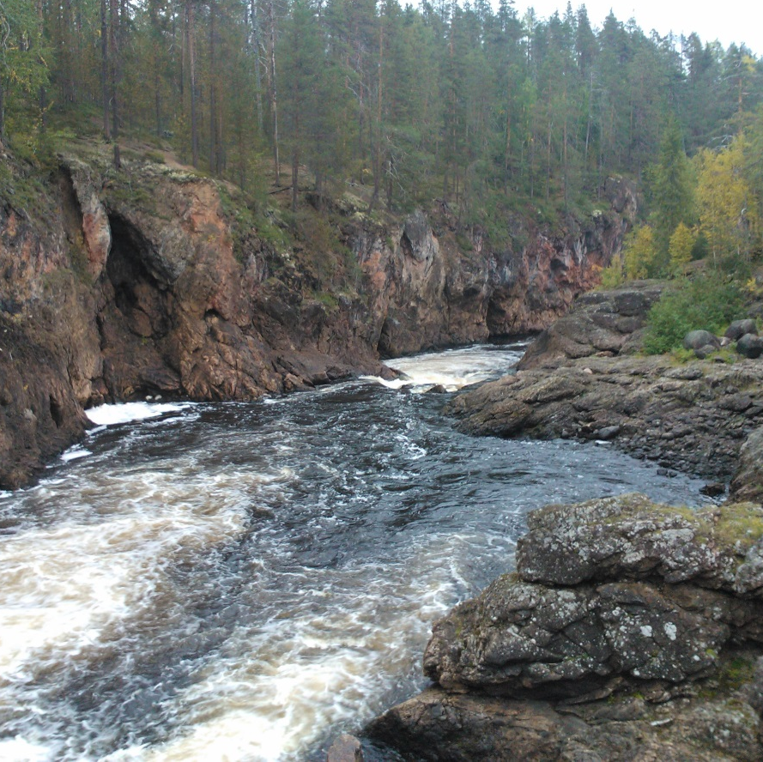

Thank you for the attention!
Contact info:
Dr Jukka Aroviita
SYKE, Freshwater Centre
Oulu, Finland jukka.aroviita@environment.fi tel #+358-400148724 http://www.syke.fi/en-us/experts/jukka_aroviita
@JukkaAroviita

